Slide 1
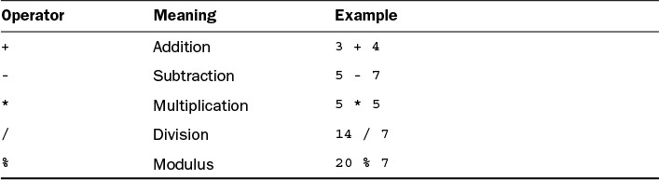
Expressions and Operators
An expression is a statement that can convey a value. Some of the most common expressions are mathematical, such as in the following examples:
int x = 3; int y = x; int z = x * y;
All three of these statements can be considered expressions; they convey values that can be assigned to variables. The first assigns the literal 3 to the variable x. The second assigns the value of the variable x to the variable y. In the third expression, the multiplication operator * is used to multiply the x and y integers, and the result is stored in the z integer.
Expressions can be any combination of variables, literals, and operators. They also can be method calls because methods send back a value to the object or class that called the method.
The value conveyed by an expression is called a return value. This value can be assigned to a variable and used in many other ways in your Java programs.
Most of the expressions in Java use operators such as *. Operators are special symbols used for mathematical functions, assignment statements, and logical comparisons.
Arithmetic
Five operators are used to accomplish basic arithmetic in Java, as shown in Table 2.3.
TABLE 2.3 Arithmetic Operators
Each operator takes two operands, one on each side of the operator. The subtraction operator also can be used to negate a single operand, which is equivalent to multiplying that operand by –1.
One thing to be mindful of when performing division is the type of numbers being used. If you store a division operation in an integer, the result is truncated to the next-lower whole number, because the int data type can’t handle floating-point numbers.
For example, the expression 31 / 9 results in 3 if stored as an integer.
Modulus division, which uses the % operator, produces the remainder of a division operation. The expression 31 % 9 results in 4 because 31 divided by 9, with the whole number result of 3, leaves a remainder of 4.

Slide 2
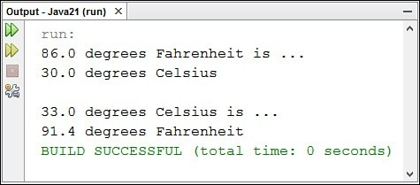
Note that many arithmetic operations involving integers produce an int regardless of the original type of the operands. If you’re working with other numbers, such as floating-point numbers or long integers, you should make sure that the operands have the same type you’re trying to end up with.
The next project is a Java class that demonstrates how to perform simple arithmetic in the language. Create a new empty Java file in NetBeans called Weather in the com.java21days package and enter the code shown in Listing 2.2 into the source code editor. Save the file with the menu command File, Save when you’re done.
LISTING 2.2 The Full Text of Weather.java
1: package com.java21days;
2:
3: public class Weather {
4:
5:
6:
7:
8:
9:
10:
11:
12:
13:
14:
15:
16:
17:
18:
19:
20:
21:
22:
23:
24:
25:
26:
27: }
public static void main(String[] arguments) { float fah = 86;
System.out.println(fah + ” degrees Fahrenheit is …”);
// To convert Fahrenheit into Celsius
// begin by subtracting 32 fah = fah - 32;
// Divide the answer by 9 fah = fah / 9;
// Multiply that answer by 5 fah = fah * 5;
System.out.println(fah + ” degrees Celsius\n”);
float cel = 33;
System.out.println(cel + ” degrees Celsius is …”);
// To convert Celsius into Fahrenheit
// begin by multiplying by 9 cel = cel * 9;
// Divide the answer by 5 cel = cel / 5;
// Add 32 to the answer cel = cel + 32;
System.out.println(cel + ” degrees Fahrenheit”);
}
Run the program by selecting Run, Run File. It produces the output shown in Figure 2.2.
FIGURE 2.2 Converting temperatures with expressions.

Slide 3
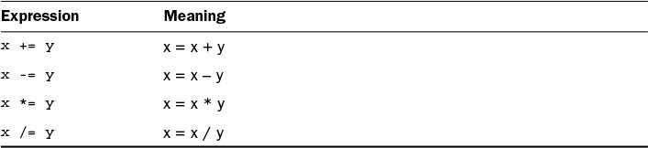
In lines 5–14 of this Java application, a temperature in Fahrenheit is converted to Celsius using the arithmetic operators:
Line 5—The floating-point variable fah is created with a value of 86.
Line 6—The current value of fah is displayed.
Line 7—The first of several comments explains what the program is doing. The Java compiler ignores these comments.
Line 9—fah is set to its current value minus 32.
Line 11—fah is set to its current value divided by 9.
Line 13—fah is set to its current value multiplied by 5.
Line 14—Now that fah has been converted to a Celsius value, fah is displayed again.
A similar thing happens in lines 16–25, but in the reverse direction. A temperature in Celsius is converted to Fahrenheit.
More About Assignment
Assigning a value to a variable is an expression because it produces a value. Because of this feature, you can combine assignment statements in this unusual way:
x = y = z = 7;
In this statement, all three variables x, y, and z end up with the value 7.
The right side of an assignment expression always is calculated before the assignment takes place. This makes it possible to use an expression statement as in the following code:
int x = 5; x = x + 2;
In the expression x = x + 2, the first thing that happens is that x + 2 is calculated. The result of this calculation, 7, is then assigned to x.
Using an expression to change a variable’s value is a common task in programming. Several operators are used strictly in these cases.
Table 2.4 shows these assignment operators and the expressions they are functionally equivalent to.
TABLE 2.4 Assignment Operators

Slide 4
Caution
These shorthand assignment operators are functionally equivalent to the longer assignment statements for which they substitute. If either side of your assignment statement is part of a complex expression, however, there are cases where the operators are not equivalent. For example, if x equals 20 and y equals 5, the following two statements do not produce the same value:
x = x / y + 5; x /= y + 5;
The first statement produces an x value of 9 and the second an x value of 2. When in doubt about what an expression is doing, simplify it by using multiple assignment statements and don’t use the shorthand operators.
Incrementing and Decrementing
Another common task required in programming is to add or subtract 1 from an integer variable. These expressions have special operators, which are called increment and decrement operators. Incrementing a variable means adding 1 to its value, and decrementing a variable means subtracting 1 from its value.
The increment operator is ++, and the decrement operator is --. These operators are placed immediately after or before a variable name, as in the following code:
int x = 7; x++;
In this example, the statement x++ increments the x variable from 7 to 8.
These increment and decrement operators can be placed before or after a variable name. This affects the value of expressions that involve these operators.
Increment and decrement operators are called prefix operators if listed before a variable name and postfix operators if listed after a name.
In a simple expression such as count--;, using a prefix or postfix operator produces the same result, making the operators interchangeable. When increment and decrement operations are part of a larger expression, however, the choice between prefix and postfix operators is important.
Consider the following code:
int x, y, z; x = 42;
y = x++; z = ++x;
The three expressions in this code yield different results because of the difference between prefix and postfix operations.
When you use postfix operators on a variable in an expression, the variable’s value is evaluated in the expression before it is incremented or decremented. So in y = x++, y receives the value of x before it is incremented by 1.

Slide 5
When using prefix operators on a variable in an expression, the variable is incremented or decremented before its value is evaluated in that expression. Therefore, in z = ++x, x is incremented by 1 before the value is assigned to z.
The end result of the preceding codes example is that y equals 42, z equals 44, and x
equals 44.
If you’re still having some trouble figuring this out, here’s the example again with comments describing each step:
int x, y, z; // x, y, and z are declared
x = 42;
y = x++;
// x is given the value 42
// y is given x’s value (42) before it is incremented
// and x is then incremented to 43
// x is incremented to 44, and z is given x’s value
z = ++x;
Caution
Using increment and decrement operators in complex expressions can produce results you might not expect.
The concept of “assigning x to y before x is incremented” isn’t precisely right, because Java evaluates everything on the right side of an expression before assigning its value to the left side.
Java stores some values before handling an expression to make postfix work the way it has been described in this section.
If you’re not getting the results you expect from a complex expression that includes prefix and postfix operators, try breaking the expression into multiple statements to simplify it.
Comparisons
Java has several operators for making comparisons among variables, variables and literals, or other types of information in a program.
These operators are used in expressions that return Boolean values of true or false, depending on whether the comparison being made is true or not. Table 2.5 shows the comparison operators.

Slide 6
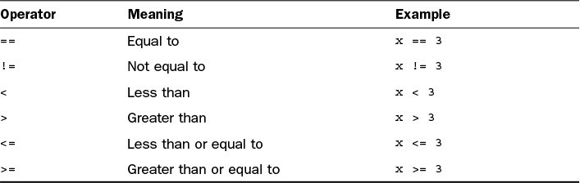
TABLE 2.5 Comparison Operators The following example shows a comparison operator in use:
boolean isHip; int age = 37; isHip = age < 25;
The expression age < 25 produces a result of either true or false, depending on the value of the integer age. Because age is 37 in this example (which is not less than 25), isHip is given the Boolean value false.
Logical Operators
Expressions that result in Boolean values, such as comparison operations, can be combined to form more complex expressions. This is handled through logical operators, which are used for the logical combinations AND, OR, XOR, and logical NOT.
For AND combinations, the & or && logical operator is used. When two Boolean expressions are linked by these operators, the combined expression returns a true value only if both Boolean expressions are true.
Consider this example:
boolean extraLife = (score > 75000) & (playerLives < 10);
This expression combines two comparison expressions: score > 75000 and playerLives < 10. If both expressions are true, the Boolean value true is assigned to the variable extraLife. In any other circumstance, the value false is assigned to the variable.
The difference between & and && lies in how much work Java does on the combined expression. If & is used, the expressions on both sides of the & are evaluated no matter what. If && is used and the left side of the && is false, the expression on the right side of the && never is evaluated.
This makes && more efficient because no unnecessary work is performed. In the preceding example if score is not greater than 75,000, there’s no need to consider whether playerLives is less than 10.
For OR combinations, the | or || logical operator is used. These combined expressions

Slide 7
return a true value if either Boolean expression is true. Consider this example:
boolean extralife = (score > 75000) || (playerLevel == 0);
This expression combines two comparison expressions: score > 75000 and playerLevel == 0. If either of these expressions is true, the Boolean value true is assigned to the variable extraLife. Only if both of these expressions are false is the value false assigned to extraLife.
Note the use of || instead of |. Because of this usage, if score > 75000 is true,
extraLife is set to true, and the second expression never is evaluated.
The XOR combination has one logical operator, ^. This results in a true value only if the Boolean expressions it combines have opposite values. If both are true or both are false, the ^ operator produces a false value.
The NOT combination uses the ! logical operator followed by a single expression. It reverses the value of a Boolean expression in the same way that a minus sign reverses the positive or negative sign on a number. For example, if age < 25 returns a true value,
!(age < 25) returns a false value.
The logical operators may seem illogical when you first encounter them. You get plenty of opportunities to work with them during the nextlectures.
Operator Precedence
When more than one operator is used in an expression, Java has an established precedence hierarchy to determine the order in which operators are evaluated. In many cases, this precedence determines the expression’s overall value.
For example, consider the following expression:
y = 6 + 4 / 2;
The y variable will equal the value 5 or the value 8, depending on which arithmetic operation is handled first. If the 6 + 4 expression comes first, y has the value of 5. Otherwise, y equals 8.
In general, the order of evaluation from first to last is as follows:
Increment and decrement operations
Arithmetic operations
Comparisons
Logical operations
Assignment expressions
If two operations have the same precedence, the one on the left in the expression is
Page 19 of 24

Slide 8
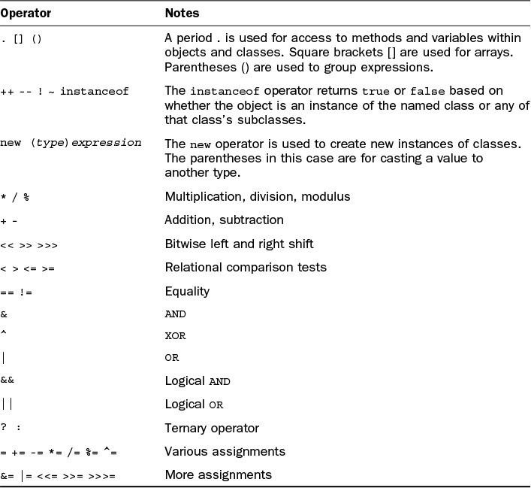
handled before the one on the right. Table 2.6 shows the specific precedence of the various operators in Java. Operators higher up in the table are evaluated first.
TABLE 2.6 Operator Precedence Several of the operators listed in Table 2.6 are covered later.
Returning to the expression y = 6 + 4 / 2, Table 2.6 shows that division is evaluated before addition, so the value of y equals 8.
To change the order in which expressions are evaluated, place parentheses around the expressions that should be evaluated first. You can nest one set of parentheses inside another to make sure that expressions are evaluated in the desired order; the innermost parenthetic expression is evaluated first.
The following expression results in a value of 5:
y = (6 + 4) / 2
The value of 5 is the result because 6 + 4 is calculated first, and then the result, 10, is divided by 2.

Slide 9
Parentheses also can improve an expression’s readability. If an expression’s precedence isn’t immediately clear to you, adding parentheses to impose the desired precedence can make the statement easier to understand.
String Arithmetic
As stated earlier, the + operator has a double life outside the world of mathematics. It can concatenate two or more strings.
The word “concatenate” means to link two things. For reasons unknown, it is the verb of choice in computer programming when describing the act of combining two strings, winning out over paste, glue, affix, combine, link, smush together, and conjoin.
In several examples, you have seen statements that look something like this:
String brand = “Jif”;
System.out.println(“Choosy mothers choose “ + brand);
These two lines result in the display of the following text:
Choosy mothers choose Jif
The + operator combines strings, other objects, and variables to form a single string. In the preceding example, the literal “Choosy mothers choose” is concatenated to the value of the String object brand.
Working with the concatenation operator is made easier in Java by the fact that the operator can handle any variable type and object value as if it were a string. If any part of a concatenation operation is a String or a string literal, all elements of the operation are treated as if they were strings:
System.out.println(4 + ” score and “ + 7 + ” years ago”);
This produces the output text “4 score and 7 years ago”, as if the integer literals 4 and 7 were strings.
There also is a += shorthand operator to append something to the end of a string. For example, consider the following expression:
myName += ” Jr.”;
This expression is equivalent to the following:
myName = myName + ” Jr.”;
In this example, += changes the value of myName, which might be something like “Robert Downey,” by adding “Jr.” at the end to form the string “Robert Downey Jr.”
To summarize today’s material, Table 2.7 lists the operators you have learned about. Be a doll and look them over carefully.

Slide 10
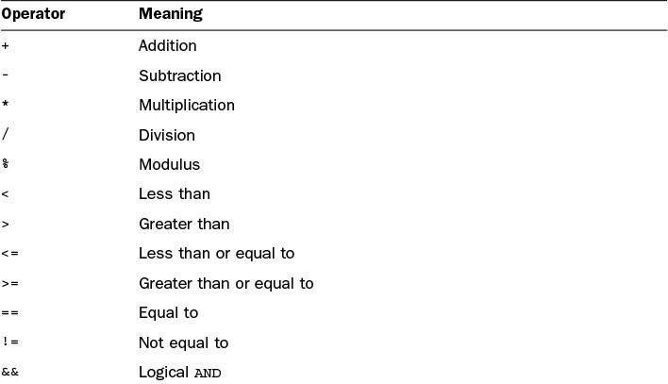
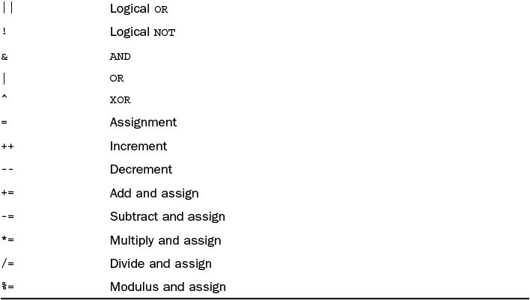
TABLE 2.7 Operator Summary
Summary
Anyone who pops open a set of matryoshka dolls has to be a bit disappointed upon reaching the smallest doll in the group.
Today you reached Java’s smallest nesting doll. Using statements and expressions enables you to begin building effective methods, which makes effective objects and classes possible.

Slide 11
Today you learned about creating variables and assigning values to them. You also used literals to represent numeric, character, and string values and worked with operators.
Later , you’ll put these skills to use developing classes.
Q&A
Q What happens if I assign an integer value to a variable that is too large for that variable to hold?
A Logically, you might think that the variable is converted to the next-larger type, but this isn’t what happens. Instead, an overflow occurs—a situation in which the number wraps around from one size extreme to the other. An example of overflow would be a byte variable that goes from 127 (an acceptable value) to 128 (unacceptable). It would wrap around to the lowest acceptable value, which is –128, and start counting upward from there. Overflow isn’t something you can readily detect in a program, so be sure to give your numeric variables plenty of living space in their chosen data type.
Small data types like byte were more necessary when computers had much less memory than they do today and every byte counted. Today, with plentiful memory and hard disk space measured in terabytes, it is better to use larger data types like int to ensure that you have enough space to store all possible values in a particular variable.
Q Why does Java have all these shorthand operators for arithmetic and assignment? It’s really hard to read that way.
A Java’s syntax is based on C++, which is based on C (more Russian nesting doll behavior). C is an expert language that values programming power over readability, and the shorthand operators are one of the legacies of that design priority. Using them in a program isn’t required because effective substitutes are available, so you can avoid them in your own programming if you prefer.
Quiz
Review today’s material by taking this three-question quiz.

Slide 12
Questions
Which of the following is a valid value for a boolean variable?
  “false”
  false
  10
Which of these is NOT a convention for naming variables in Java?
  After the first word in the variable name, each successive word begins with a capital letter.
  The first letter of the variable name is lowercase.
  All letters are capitalized.
Which of these data types holds numbers from –32,768 to 32,767?
  char
  byte
  short
Quiz
Review today’s material by taking this three-question quiz. Questions
Which of the following is a valid value for a boolean variable?
  “false”
  false
  10
Which of these is NOT a convention for naming variables in Java?
  After the first word in the variable name, each successive word begins with a capital letter.
  The first letter of the variable name is lowercase.
  All letters are capitalized.
Which of these data types holds numbers from –32,768 to 32,767?
  char
  byte
  short
Exercises
To extend your knowledge of the subjects covered today, try the following exercises:
Create a program that calculates how much a $14,000 investment would be worth if it increased in value by 40% during the first year, lost $1,500 in value the second year, and increased 12% in the third year.
Write a program that displays two numbers and uses the / and % operators to display the result and remainder after they are divided. Use the \t character escape
code to make a tab character separate the result and remainder in youPragoe 2u4topf u24t.

